Slide 1





MOONQUAKE MAP 2.0
by Pratham Sorte,
Shaunak Samant,
Aryan Vaze,
Rishabh Alekar,
Parth Ashtaputre and
Rudolph Smith

Slide 2
The Challenge
Objective:
When they explored the Moon, NASA’s Apollo astronauts left behind several instruments to collect geophysical data near each Apollo landing site. Your challenge is to develop an app for the public that plots the seismic data these instruments transmitted back to Earth on an interactive
3-D digital moon globe.

Slide 3
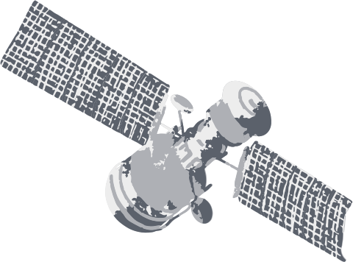
What are Moonquakes?
Information about moonquakes comes from seismometers placed on the Moon from 1969 through 1972. The instruments placed by the Apollo 12, 14, 15 and 16 missions functioned perfectly until they were switched off in 1977.
A moonquake is the lunar equivalent of an earthquake (i.e., a quake on the Moon) although moonquakes are caused in different ways. They were first discovered by the Apollo astronauts. The largest moonquakes are much weaker than the largest earthquakes, though their shaking can last for up to an hour, due to fewer attenuating factors to damp seismic vibrations.

Slide 4
Deep Moonquakes
700 km below the surface, probably tidal in origin.
Thermal Moonquakes
Shallow Moonquakes
The frigid lunar crust expands when sunlight returns after the two-week lunar night.
50–220 kilometers below the surface.

Slide 5


Apollo 11, launched in July 1969, achieved the historic feat of landing humans on the Moon, with Neil Armstrong and Buzz Aldrin as the first lunar walkers. Apollo 13, in April 1970, faced adversity but safely returned to Earth. Apollo 15, launched in July 1971, set records for lunar surface time and introduced the Lunar Roving Vehicle. Apollo 17, December 1972, marked the final moon landing. The Lunar Reconnaissance Orbiter (LRO), launched in 2009, is an unmanned mission dedicated to mapping and studying the Moon's surface and environment, providing essential data for future lunar exploration endeavors.
The NASA Moon Missions

Slide 6


Why pay attention to Lunar Seismology?
1. Understanding Lunar Geology
2. Determining Lunar Interior Structure
3. Lunar Exploration and Resource Assessment
4. Engineering and Infrastructure
5. Astronomy and Science Experiments
6. Historical Data Analysis
This information can be beneficial to young aspiring astrophysicists and for certain educational groups who are interested to know more about the space & its significant events

Slide 7
THANK YOU

